Slide 1
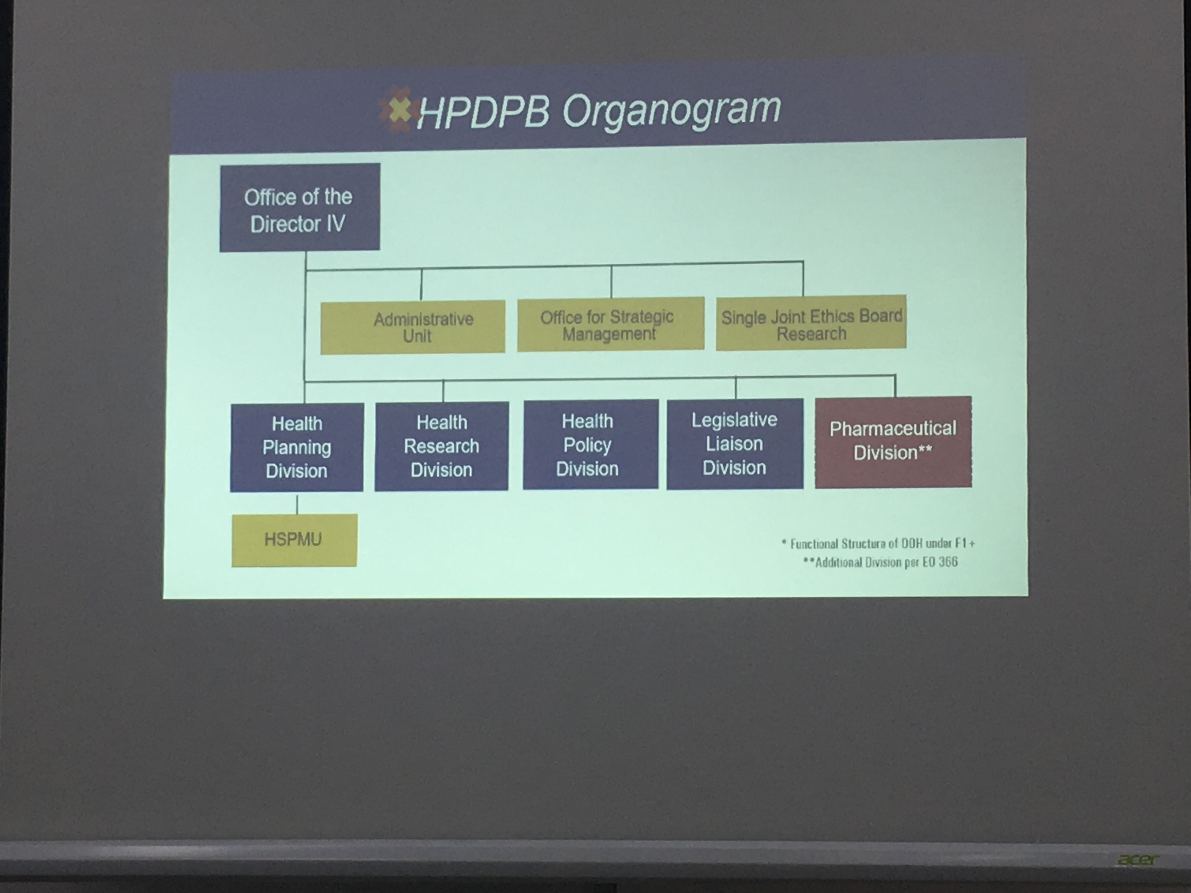
Office of the
Director IV
Administrative Unit
Office for Strategic Management
Single Joint Ethics Board Research
Health Planning Division
Health Research Division
Health Policy Division
Legislative Liaison Division
Pharmaceutical Division**
*Functional Structure of DOH under F1+
**Additional Division per EO 366

